Slide 1
文本分析可视化
Lesson-15

Slide 2
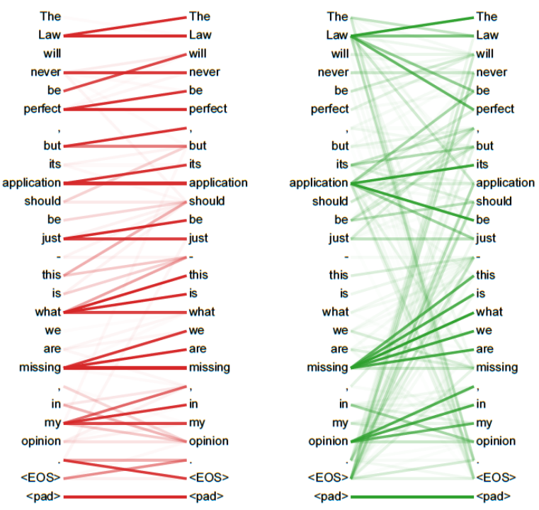
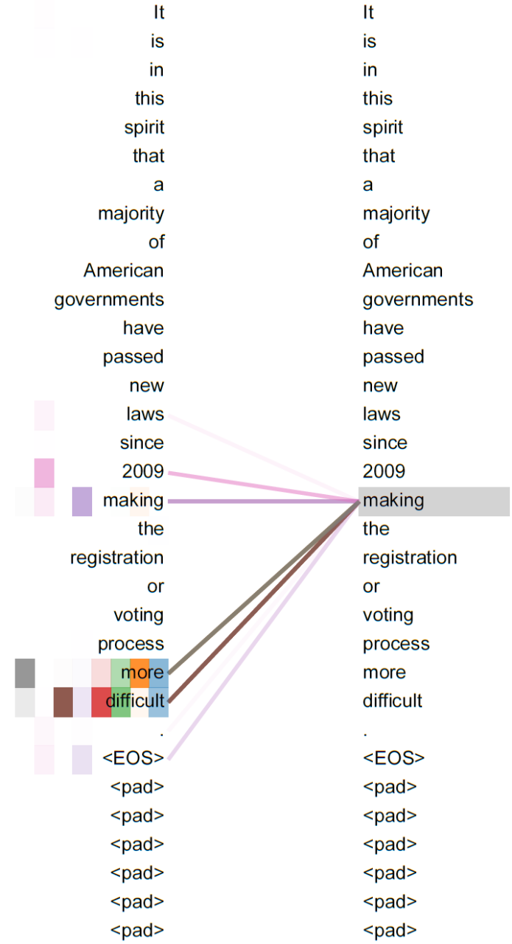
Attention is all you need

Slide 3
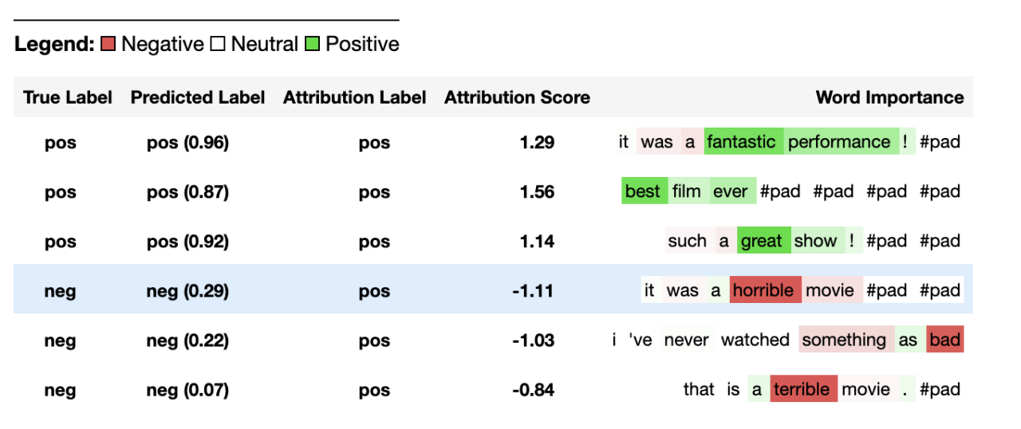
https://captum.ai/tutorials/IMDB_TorchText_Interpret

Slide 4
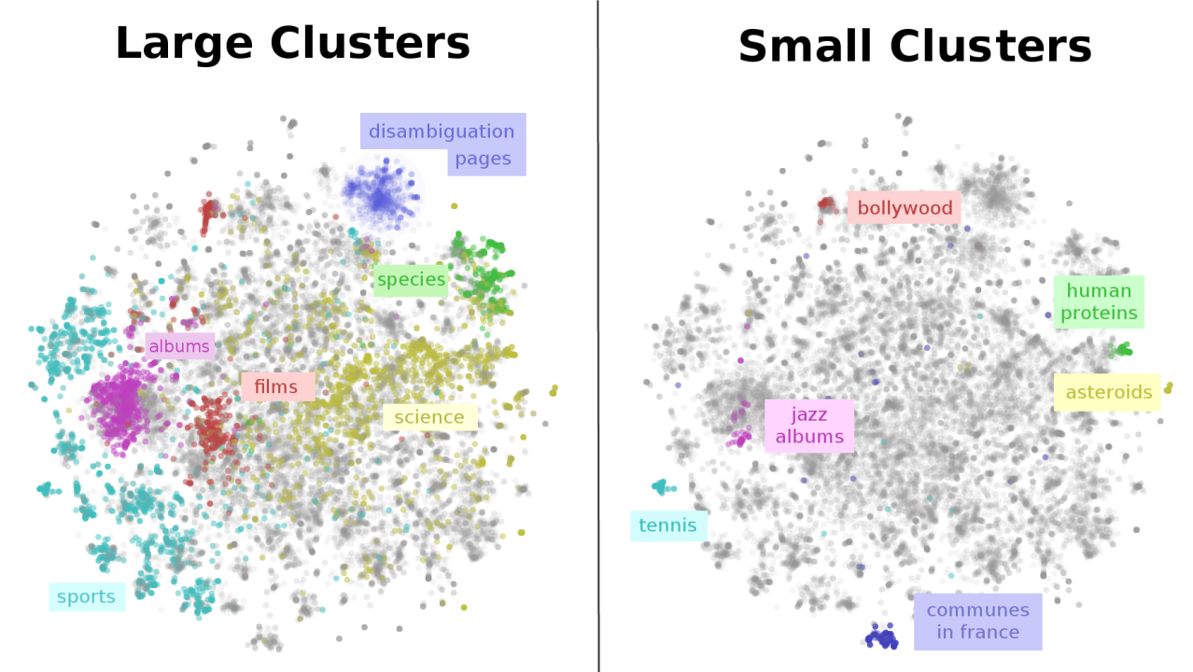
Map of Wikipedia（https://colah.github.io/posts/2015-01-Visualizing-Representations/）

Slide 5
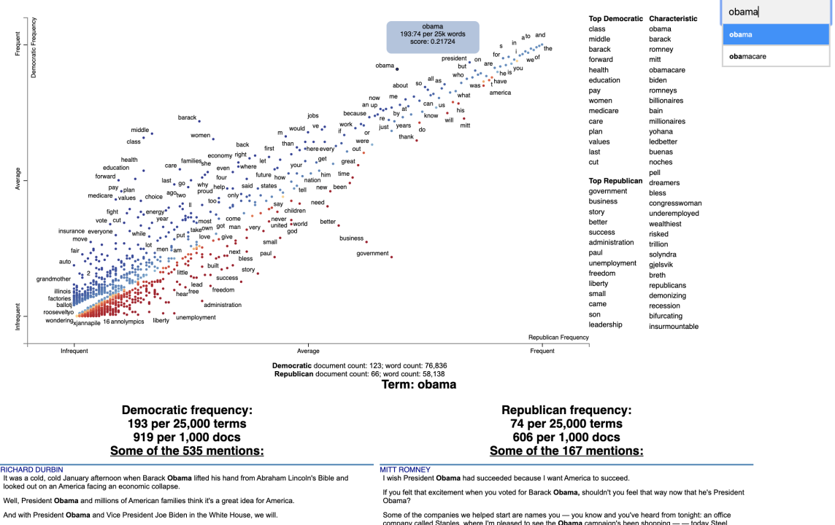
scattertext （https://github.com/JasonKessler/scattertext）

Slide 6
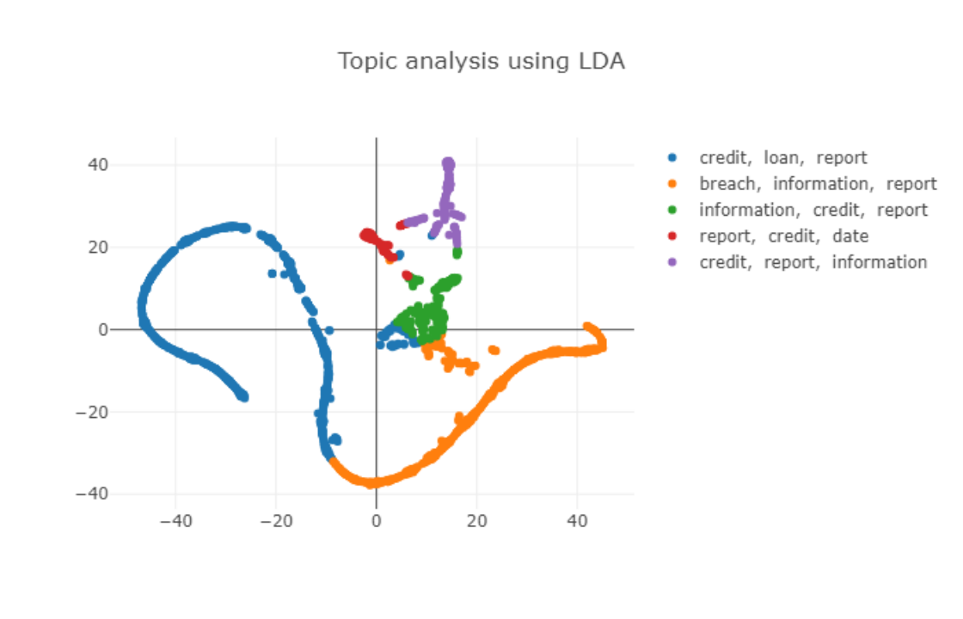
plotly （ https://github.com/plotly/dash-sample-apps/tree/main/apps/dash-nlp ）

Slide 7
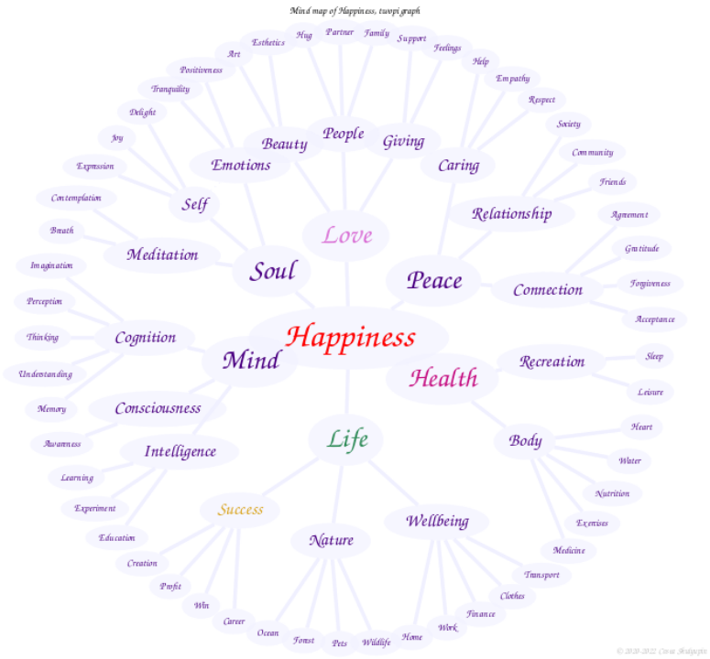
graphviz （ https://graphviz.org/Gallery/undirected/happiness.html ）

Slide 8
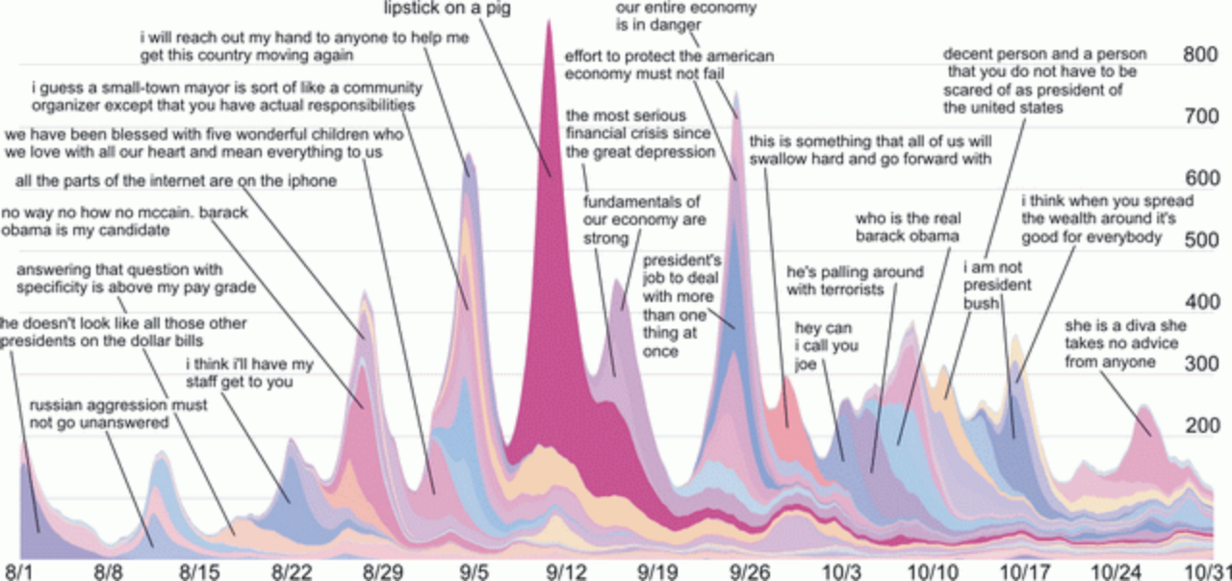
memetracker （ http://snap.stanford.edu/memetracker/ ）

Slide 9
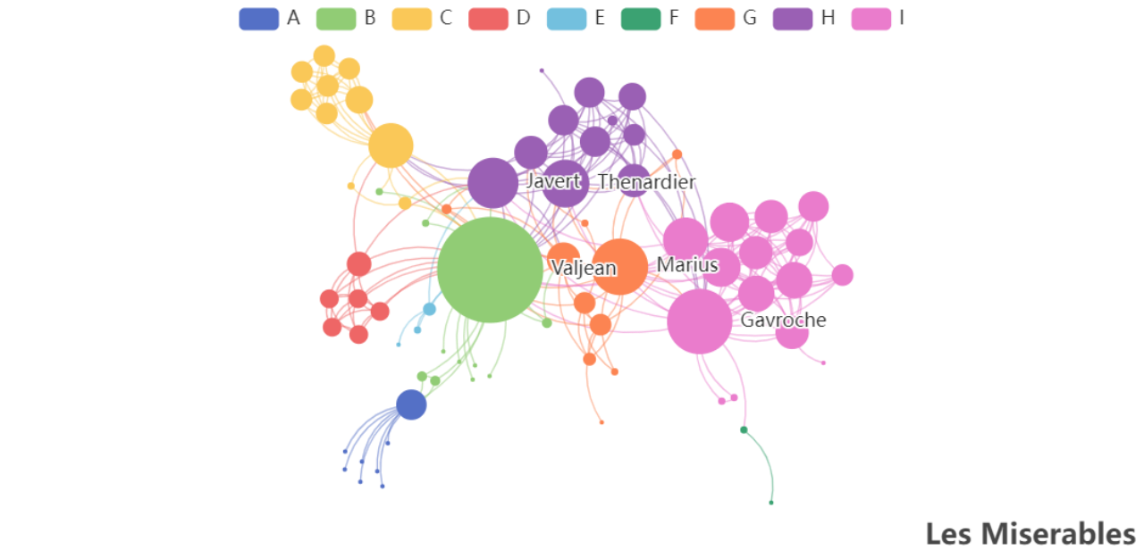
Echarts-关系图 （ https://echarts.apache.org/examples/zh/editor.html?c=graph ）

Slide 10
开源工具或package
echart
D3
Networkx
Gephi

Slide 11
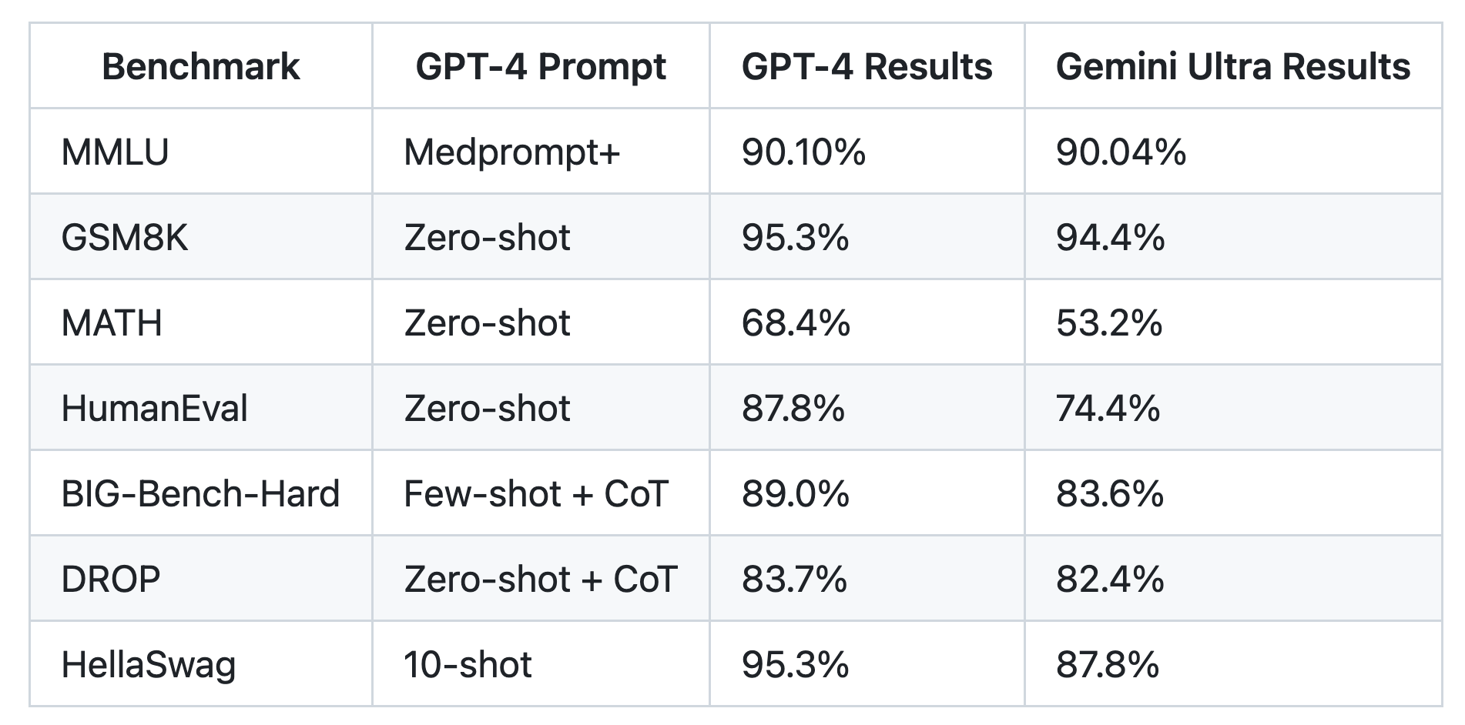
大模型提升指令t-promptbase
https://github.com/microsoft/promptbase
https://mp.weixin.qq.com/s/GMC29rUkBeS8H7xJxN4_Gg
https://mp.weixin.qq.com/s/LwNFfwiHCED9AjB2su0C-g

Slide 12
谢谢

